Slide 1
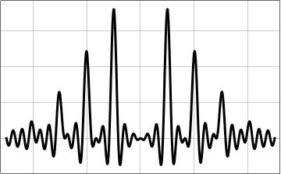
Analysis techniques
Daniel Diego Carpintero
Facultad de Ciencias Astronómicas y Geofísicas,
Universidad Nacional de La Plata
Instituto de Astrofísica de La Plata (Conicet-UNLP)

Slide 2
time-tag events
Different kinds of observations/data:
binned event data
time-to-spill events
point observations
point observations
Fourier transform
Fourier transform
Fourier methods
Schuster periodogram
Schuster periodogram
Lomb-Scargle periodogram
Lomb-Scargle periodogram
Correlation functions
Wavelets
String length
Phase-folding methods
Analysis of variance
Conditional entropy
Lomb-Scargle periodogram
Least squares methods
Lomb-Scargle periodogram
Supersmoother approach
Phase binning
Bayesian methods
Stochastic processes
Notes:
time-tag events: conteo de fotones
binned event data: Cherenkov telescope en cubos
time-to-spill events: time to accumulate a fixed number of counts (gamma ray bursts)
supersmoother approach: local linear regression

Slide 3
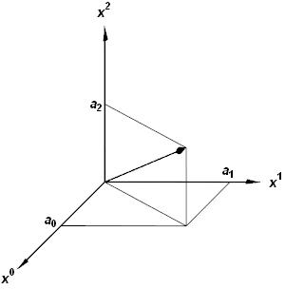
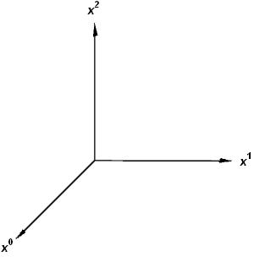
The (continuous) Fourier transform
(or: Fourier analysis of continuous signals)

Slide 4
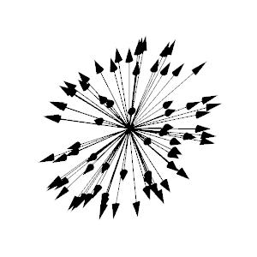
= the Taylor series
a_{n}² is the power with which the exponent n
contributes to the function f

Slide 5
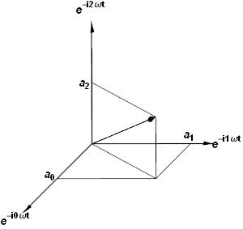
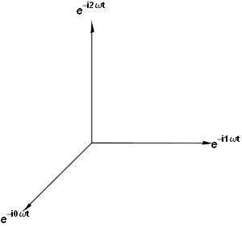
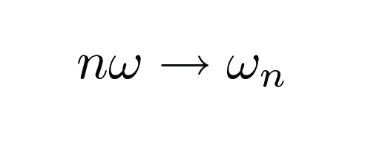

Slide 6
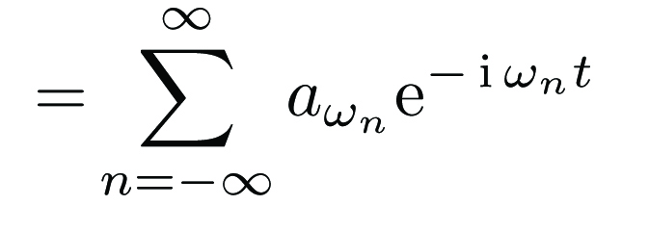
= the Fourier series
| g_{ωn} |² is the power of the frequency ω_{n} with which it contributes to the function f

Slide 7
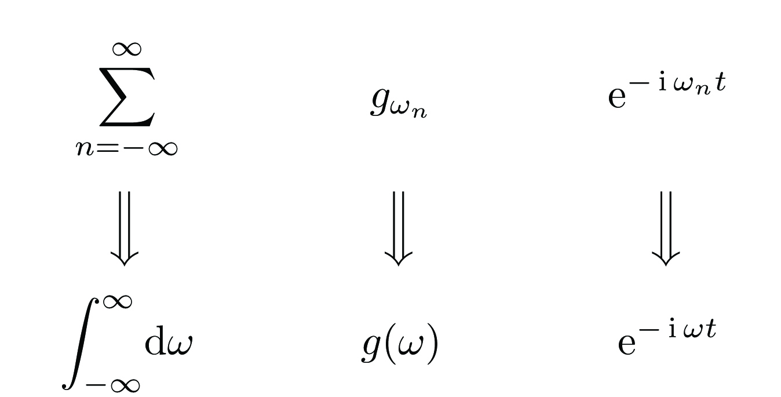
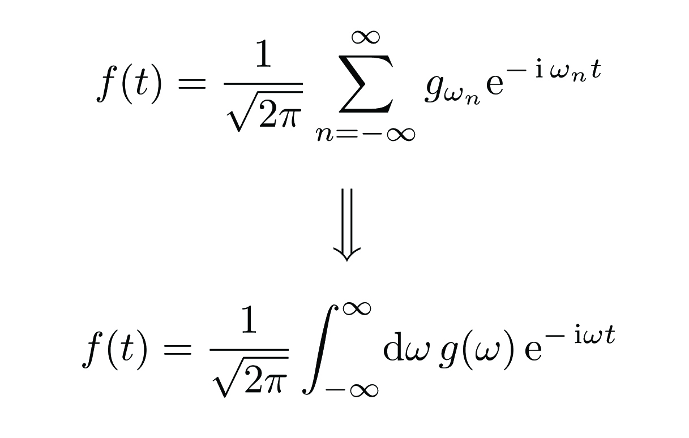
Going from discrete to continuous...
inverse Fourier transform
| g(ω) |² as a function of ω is the power spectrum of f

Slide 8
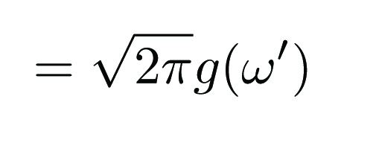
How to compute g(ω)
The Fourier transform

Slide 9
Some properties...
time scaling
frequency scaling
time shifting
frequency shifting
i.e., the power spectrum is even

Slide 10
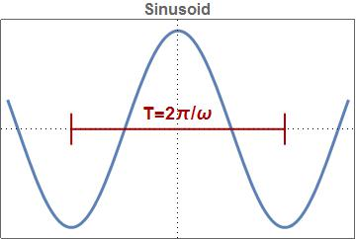
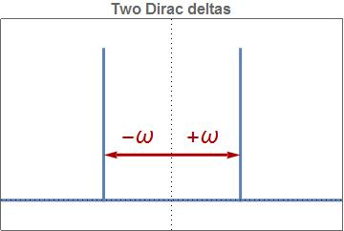
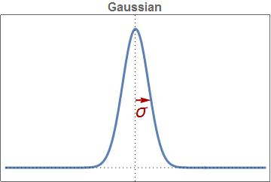
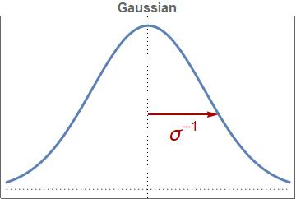
Power spectrum: "positive real-valued function that
quantifies the contribution of each frequency ω to the total signal"
Examples:

Slide 11
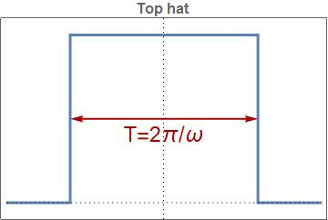
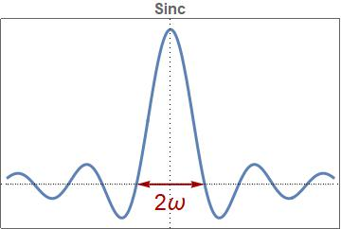
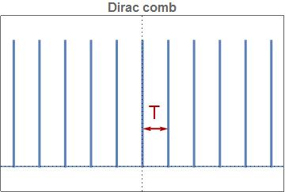
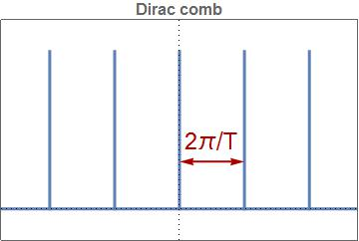
More examples:

Slide 12
Convolution
Convolution theorem:
Corolary:
The power spectrum is always convoluted with the observing window

Slide 13
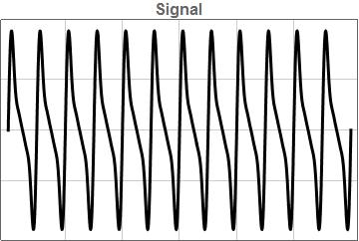
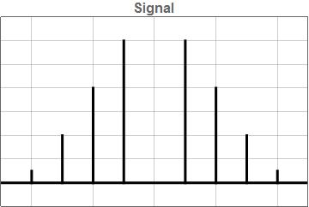
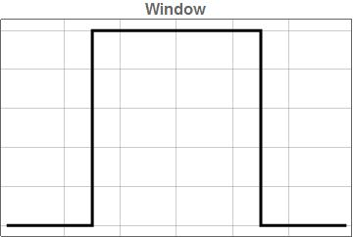
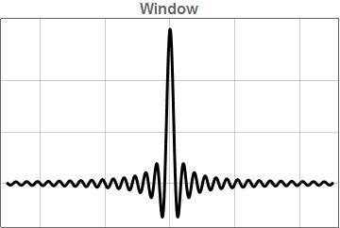
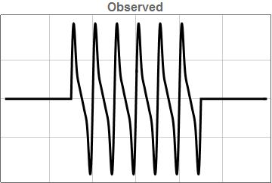
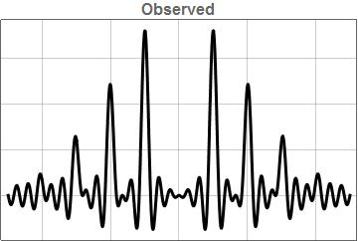
Example:
×
*
=
=

Slide 14
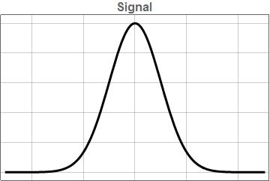
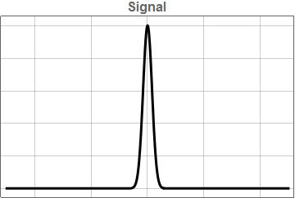
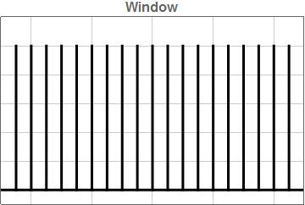
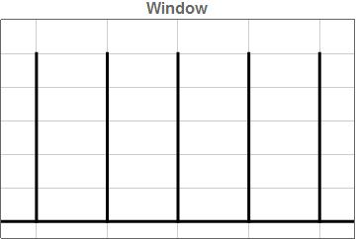
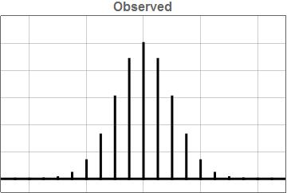
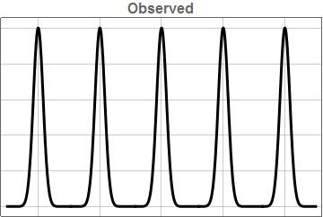
Another example:
×
*
=
=

Slide 15
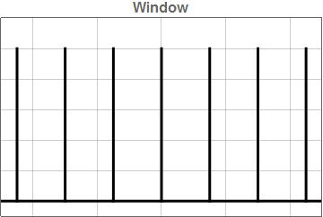
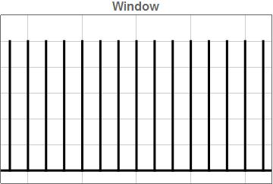
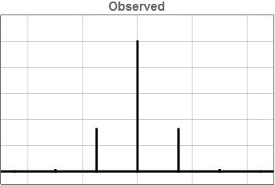
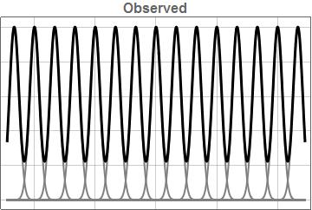
Yet another example:
×
*
=
=

Slide 16
The Nyquist limit
Only a function whose Fourier transform can fit entirely between the teeth of the comb is able to be fully recovered.
Therefore, with a sampling rate of 2π/T = ω₀, the signal should be band-limited between frequencies ±ω₀/2.
Nyquist sampling theorem (from the other direction): to fully represent the frequency content of a band-limited signal ±ω₀, we must sample the data with a rate of at least ω_{Ny} = 2ω₀.

Slide 17
The discrete Fourier transform
Let f(t) be an infinitely long and continuous signal, but observed at a regular grid with spacing Δt:
The Fourier transform:
In the real world: finite number N of samples
→ apply rectangular window function of width NΔt

Slide 18
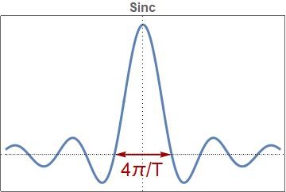
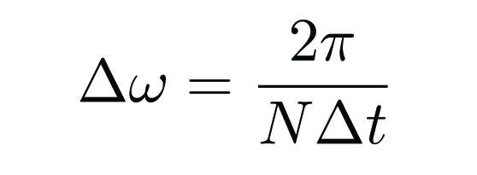
The discrete Fourier transform
It is the Fourier transform of the signal sampled at intervals Δt and convolved with a sinc function of width 4π/T = 4π/(NΔt)
Nyquist: any two powers at frequencies within 2π/(NΔt) of each other will not be independent → we should space our frequencies with Δω ≥ 2π/(NΔt) → we sample at N evenly spaced frequencies with:
The discrete Fourier transform
Note: optimal spacing in terms of both the Nyquist sampling and the effect of the finite observing window.

Slide 20
The classical periodogram
Note: ω continuous. It is the Fourier power spectrum for a continuous signal observed with uniform sampling defined by a Dirac comb.
Max ω to use: the Nyquist frequency.
Beyond that → "aliases".

Slide 21
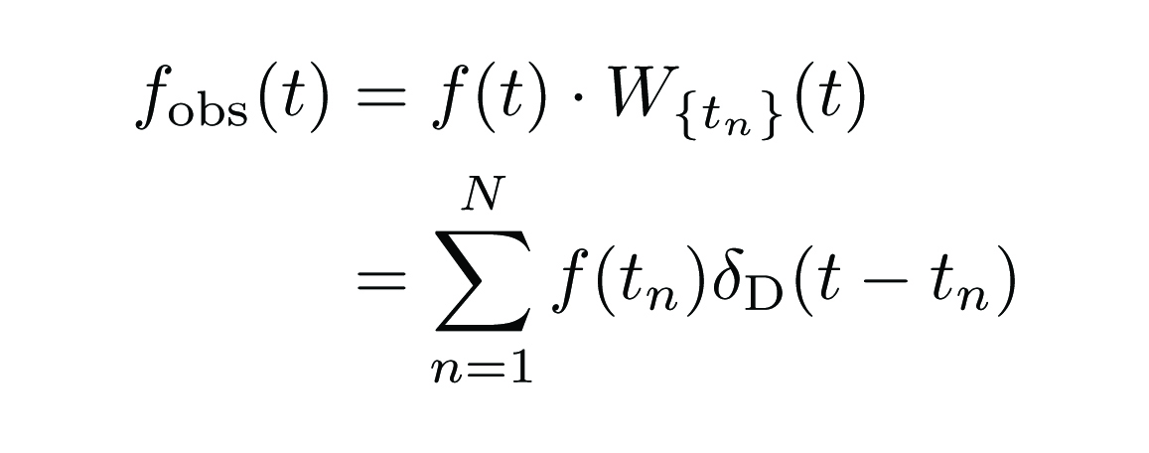
Non-uniform sampling

Slide 22
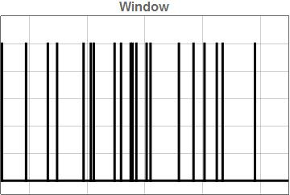
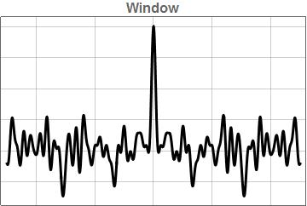
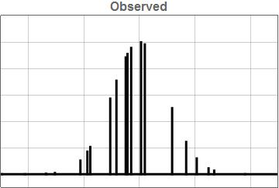
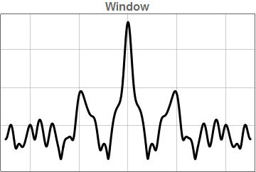
Non-structured spacing of observations leads to non-structured frequency peaks in the window transform.
×
*
There is no exact aliasing of the true signal, and thus no way to exactly recover any portion of the true Fourier transform of the underlying function.
=
=

Slide 23
Nyquist frequency with uneven sampling
Uneven sampling destroys the symmetry that led to the concept of Nyquist frequency.
Typical approaches to pseudo-Nyquist limits:
mean of the sampling intervals
harmonic mean of the sampling intervals
median of the sampling intervals
minimum sampling spacing
None is correct: unevenly sampled data can probe frequencies far larger than any of these limits

Slide 24
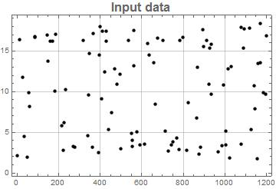
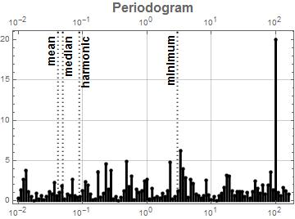
ω = 100
Signal:
10 + 7.5 sin(100· t) + 13% white noise
100 random points between t = 0 and t =1200

Slide 25
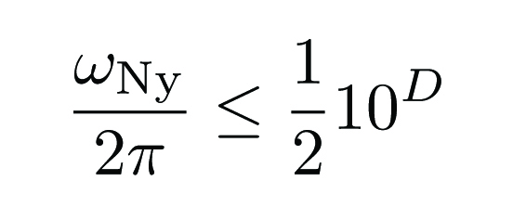
Eyer & Bartholdi (1999, A&AS, 135, 1):
The equivalent Nyquist frequency is 2π/(2p), where p is the largest factor such that each spacing Δt_{i} is exactly an integer multiple of this factor.
Corolary: If any pair of observation spacings has an irrational ratio, the Nyquist limit is infinity!
Finite precision of the observations means that the Nyquist frequency can be large, but not infinite:
where D is the number of decimal places to which the observation times were recorded.

Slide 26
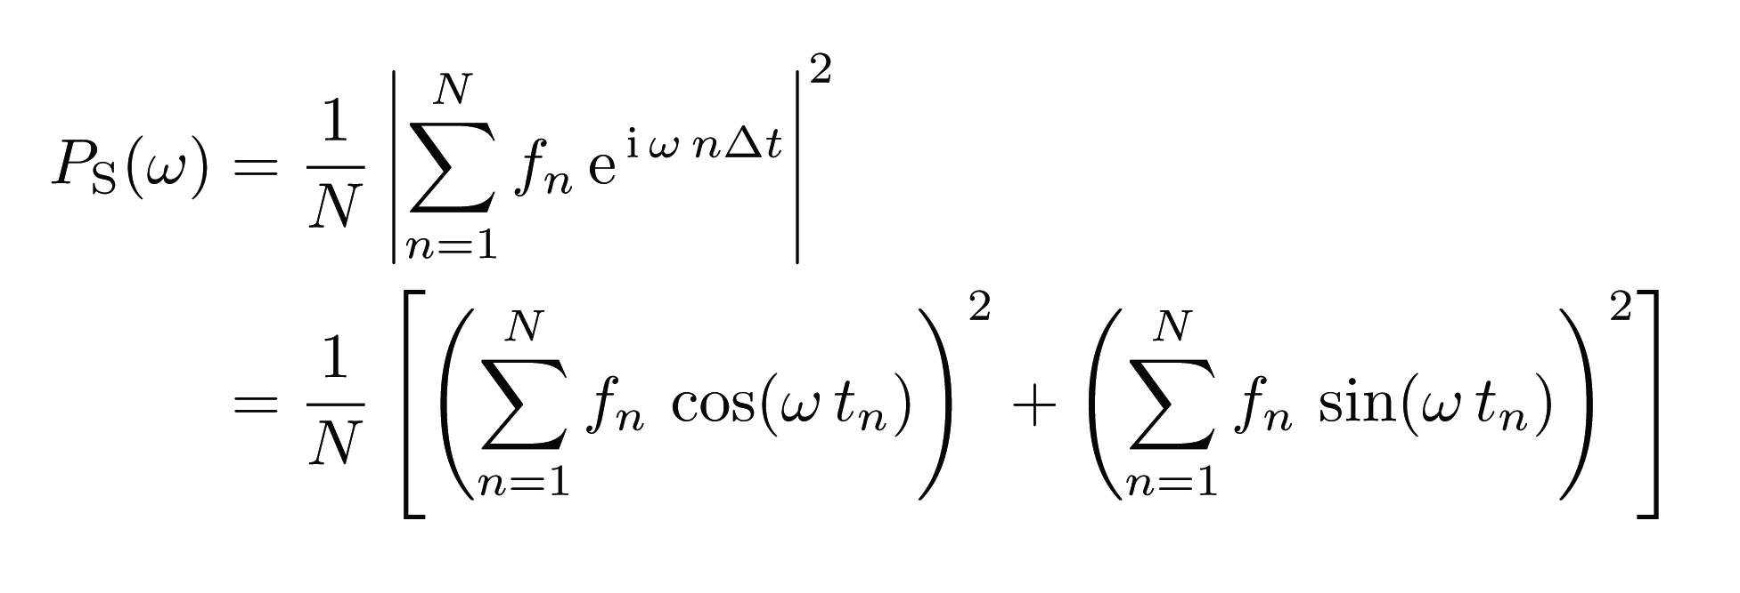
The Lomb-Scargle periodogram
Classical:
If the signal is pure Gaussian noise and it is sampled uniformly, then the values of the periodogram are chi-square distributed.
Thus, if a signal is present it is easily detectable.
Uneven sampling: this property is completely lost.

Slide 27
The Lomb-Scargle periodogram
Scargle (1982, ApJ, 263, 835) solved this problem :
(A, B, τ functions of ω)
There is a unique form of the three functions such that:
1. The periodogram reduces to the classical form in the case of
equally-spaced observations.
2. The periodogram's statistics are analytically computable.
3. The periodogram is insensitive to global time-shifts in the data.

Slide 28
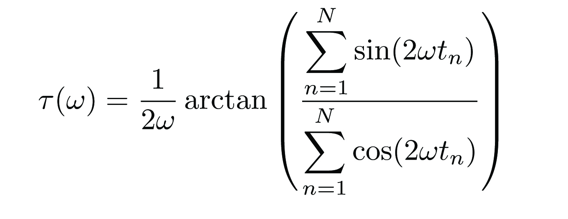
The Lomb-Scargle periodogram
where

Slide 29
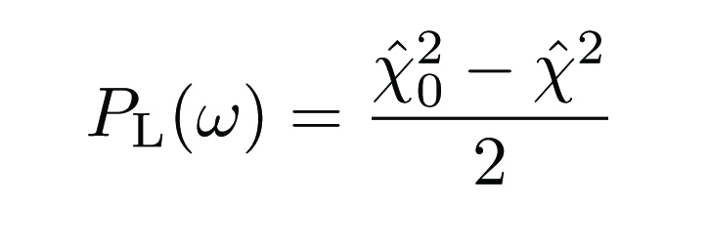
Least-squares interpretation
A remarkable feature (Lomb, 1976, Ap&SS, 39, 447): the Scargle periodogram is identical to the result obtained by fitting a model consisting of a sinusoid at each candidate frequency ω:
If we call χ̂² the value obtained by minimizing χ²(ω) at each frequency with respect to A_{ω} and φ_{ω}, and
then the Lomb-Scargle periodogram can be written

Slide 30
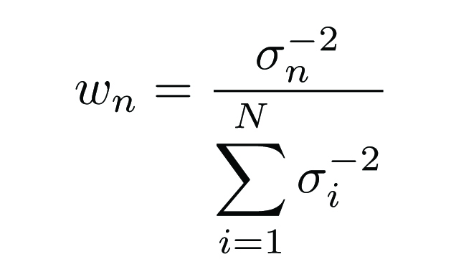
Least-squares interpretation
Measurement errors

Slide 31
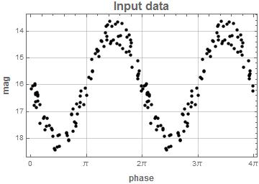
The problem of the mean
Signal:
16 + 2 sin(ω· t) + white noise
ω = 2π 0.3
100 random points between t = 0 and t =100

Slide 33
The problem of a lost range

Slide 34
The problem of a lost range
The solution: a floating mean
(date-compensated discrete Fourier Transform, generalized Lomb-Scargle periodogram)
adds an offset term at each frequency:

Slide 35
Computing with a floating mean:

Slide 36
Uncertainties: peak width and frequency precision
Signal:
sin(ω· t) + white noise
ω = 2π· 1
N random points between t = 0 and t =1000
To first order, the width of the peak does not depend on either the number of observations or their signal-to-noise ratio!

Slide 37
Rationale: to compare the height of the peak against the background peaks; i.e., to quantify the significance of a peak.
False alarm probability
FAP: given a peak, the probability that a dataset with no signal (Gaussian noise) would lead to a peak of that magnitude (or greater).
Scargle: if the data are pure Gaussian noise, the values of P_{LS}(ω) follow a χ² distribution with 2 DOF. Let Z = P_{LS}(ω) be the value of the periodogram at frequency ω. Then the PDF of Z is
The cumulative probability will then be
so the statistical significance of a given power at a preselected frequency will be
that is, it becomes exponentially unlikely that such a power level or greater can be due to a chance noise fluctuation.

Slide 38
False alarm probability
Let Z_{m} be the value of the maximum peak in a spectrum composed of N frequencies such that their powers are random variables. Then the multiplicative property of the probability of independent events leads to
Then, the probability that a peak will be the maximum among N powers only by chance is:
Finally, the level z such that a maximum (among N values) with this height has a probability p of being obtained only by chance is:

